Slide 1
DEVELOP AN OUTCOME L2
Evidence of Learning Template
18234
Developing a Outcome for the checkers Project
ADITYA SINGH

Slide 2
Github /Drive link
Trello board or PM link
You MUST provide evidence showing how the problem has been decomposed, how the components have been developed and trialled, and of how they have been assembled and tested to create a final, working outcome.

Slide 3
Project management: Setup
1.)Record evidence that you have setup project management tools to manage the development of your outcome.
2.)Record evidence that you have chosen project management techniques to manage the development of your outcome.
3.)Record evidence that you have setup/ chosen version control tools/techniques to manage the development of your outcome.
4.)Explain why you believe that these tools and techniques are appropriate for the development of your outcome.

Slide 4
The Monday.com techniques I worked with?
The technique in the monday.com I used in the following were the breakdown of the week as I made a date of deadline in the column in the side of the week and I wanted to dop something about the in the trialing and it was quite easy to make in a way because it had helped me in making the best outcome for m planning process.I had to set up a reminder in each of the weeks to tell me if I was going on track with all of the procedures and how much timeline i would have to complete the project fully by a designated deadline. Time, it was a component that I had so much of so I had to designate each of the task in a colum so i knew which one would eb the most important to work with first.

Slide 5
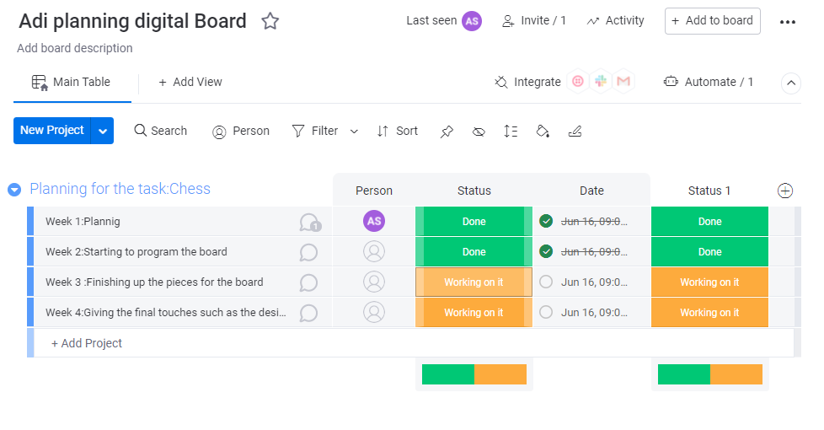
1.)Planning For the Checkers Project

Slide 6
Planning for The Project
I had used Monday.com to plan all the different stages of my program and the different weeks I was going to work on it.I had taken a decision on my self to divide the work in 4 weeks where making the most priorioty part at the end and the most easiest one at the start.This strategie had helped me to just keep me on track Monday.com was quite a bit difficult because I had to login into the website everytime and sometimes it would log me out and wouldn’t let me edit the planning.The calender was really good for planning as it highl;ighted as a different necessity of each week because I had to know which was the most essential so I could highlight in a different colour and plan before hand before hand so I knew that I wouldn’t run out of time and then that made me know that I was time Managing and knew what I had to do.

Slide 7
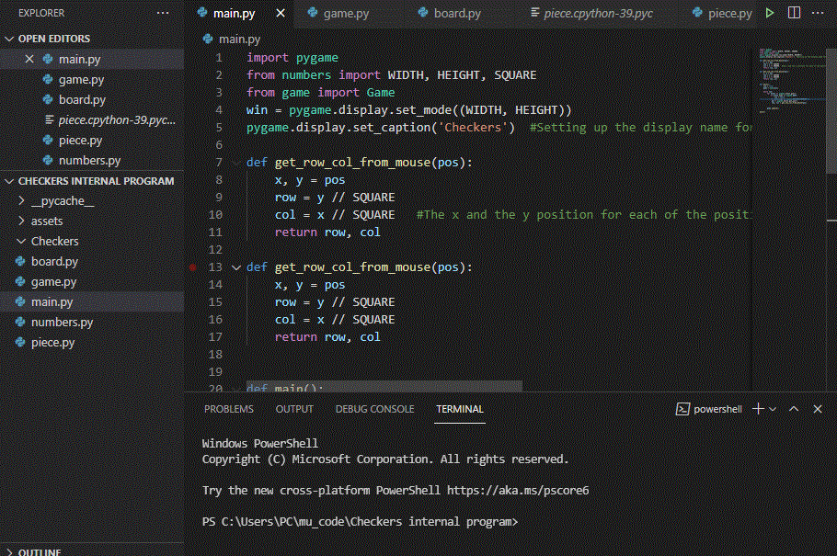
Decomposing outcome
Record evidence that you have broken the outcome into smaller components.
In this project i had to make do small components one by one so that I could make my end product. I had divided my components in 5 section which consisted of the following:
Piece
Number
Game
Board
Main
Out of all all of these I had designated a limited amount of time on each of them as all of them had to be right and accurate for the project to run smoothly.

Slide 8
Trialling components
Record evidence that you have trialled components. Show that you gathered information to inform your decision making.
Record evidence that you have trialled multiple components and have selected those most suitable.
Record evidence that you have used information from trialling appropriately to improve the functionality of the outcome.

Slide 9
Trialing Components
One of my trialing components in the program was the idea of understanding which different components I had to use to make my project worthwhile. As a example was one of them about colour. I had to choose the right colour for the following pieces so they would be able to contrast easily with my checkers board. A another trialing component was the different sizes I ahd to consider of how how long should I make each size square for each unique piece. I hd tried to out a variety of selections through the week and at teh end of the whole project I ahd considered the ebay one which could have contrasted well with the whole project.

Slide 10
Testing outcome
Record evidence that you have tested your outcome.
Explain how the testing made sure your outcome functions as intended to meet its purpose and requirements.
Record evidence that you have used information from testing appropriately to improve the functionality of the outcome.

Slide 11
Testing Outcome
In my testing outcome their were a lot of controls I had to keep testing over and over again so I would be sure that they had worked really well.The component I had to test the most so that I was sure if it was working or not was the Board because it had a lot of varieties of code written in it which consisted of the values of the specific board square size number and this meant that sometimes it would mostly not work due to a wrong setting in the code work. The other component was the pieces because they required a lot of code work on the padding size and the colour numbers which would match with the intended outcome.

Slide 12
Version Control
Your version control evidence should go here. This could be in the form of annotated screenshots which show you you managed this process or you could make a brief screencast explaining how you implemented version control.

Slide 13
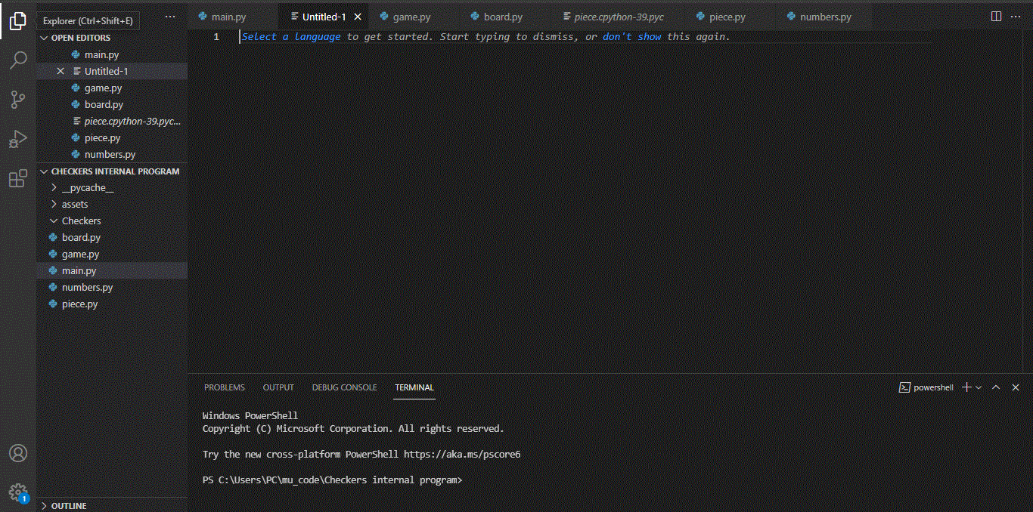
Screen Shot 1
My setup for making the code with all the 5 folders ready to make the project.

Slide 14
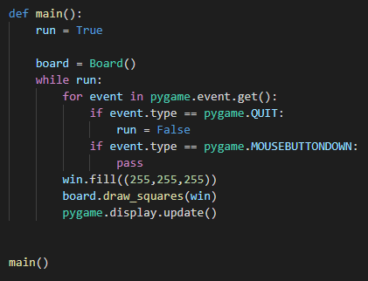
Screen Shot 2
This the main where I have written all of the board settings.

Slide 15

Screen Shot 3
Written my values for the height and with of the square all with rows and columns.

Slide 16
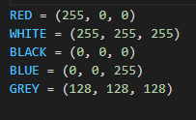
Screen Shot 4
Colour Code numbers for each of the colours I was going insert.

Slide 17
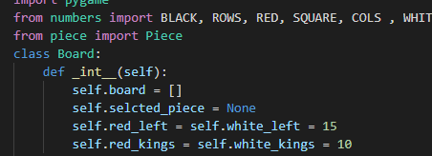
Screen Shot 5
Pieces for the following boards in the squares.

Slide 18
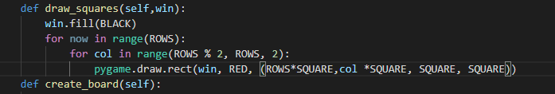
Screen Shot 6
Drawing the following square in the board.

Slide 19
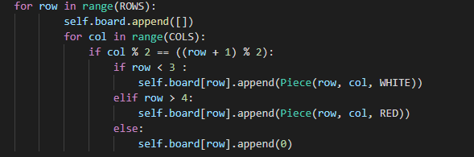
Screen Shot 7
Using all the pieces with the row and the column.

Slide 20
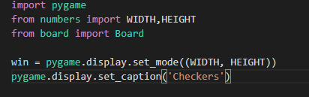
Screen Shot 8
Importing pygame and the width and the height with the board.

Slide 21
Project management: Applied
Record evidence that you have used your project management tools to manage the development of your outcome.
Record evidence that you have used your project management techniques to manage the development of your outcome.
Record evidence that you have used version control tools to manage the development of your outcome.

Slide 22
Project Management
The project management was the key essential thing to this project because I really had to manage all of my time into one thing and had to focus the outcomes of what components I had to work on at the end and this had made me to work twice as hard. Each screenshot I have taken above had to be coded within specific time frame or else it wouldn’t have amde it through. I had to divide the section above to the most essential parts, in this case it would have been the board file where the most work had been done top improve and upgrade the checker board.

Slide 23
Relevant Implications
Explain the relevant implications here. Please watch this video to learn how to do this.
Explain the Implications that are relevant to your outcome.
Record evidence that you have addressed the Implications that are relevant to your outcome.

Slide 24
Relevant Implication 1:Privacy
I decided on taking Privacy as one of the implication because this one was very easy to talk about in my project that I had made. I had kept people’s privacy as a must when i was making my project because I didn’t want my customers to think that their private information werent being shown to outer networks. A example of this would have been not asking their names for when they are playing the Game because I didnt want anyone else knowing who was playing the particular game so any anonymous player could have played it. In my project I havent asked for any of their personal information such as location which may make some of the viewers quite distured and quite uncomfortable without them giving their consent.

Slide 25
Relevant Implication 2:Usability
The second Implication I had decide on was Usability, this was because i wanted to talk about how easy my program was to run for the my audience.This was a great implication to talk about because this had helped me in talking about how easy and quick my program to talk about. My program was simple in just running the program and playing the game without any hassle. I feel that I hadn’t think about the components like consistency because that might become a very big factor in the audience way of using the game. In example if one person get’s it slower then the other person then they might lose the interest in playing the game.

Slide 26
Relevant Implication 3: Accessibility
I decided on taking Acessibility as a factor in my project because I felt that my checkers project was really easy to be accessible and was easy for my target audience of any ages. They wouldn’t have to worry about so much of the complex access to the game instead tehy would just click a button and easily access the document. I feel like I hadn’t taken consideration of People with disabilities and probelmems such as colour blind people who would have really hard time keeping up with the problems of how a colour blind person would see the different coulours displayed on the screen.

Slide 27
Relevent Implication 4: Health and Safety
To my understanding in this project I had kept a good understanding of the health and safety conditions because no part of my project contains any type of inappropriate images which could disturb the thinking to my audience. I haven’t use any extreme bright coulours which could cause eye strain to people and make them have a tough time ssing the image after a while.It is completely safe to any one and causes no problem to a person’s physical and emtal health.

Slide 28
Evaluate
Discuss how the information from planning, testing and trialling of components assisted in the development of a high-quality outcome.
To conclude everything, I thought that I had worked really well and hard to make the project and I was well happy for making the board and the pieces to appear. My planning and time management was allright, I think I had lost control over the time management strategy and slowly some of my parts of my program were a bit missing but I tried my best to commit to the task and was really happy for the end result. I was truly happy about the trialing process I had done so many times to make my program look and feel better and better to my audience.My planning was done extremely well I thought, I had designated each oif the tasks in the particular time frame and mostly I had met the limits of finishing the task. The only thing I would mostly work on next time would be Time Management.

